Slide 1

REsTAURANT ORDER ANALYSIS
BHAGYAVANTHA​​

Slide 2
SITUATION
You’ve just been hired as a Data Analyst for the taste of the World Café, a restaurant that has diverse menu offerings and severe generous portion.

Slide 3
CHALLENGES
The Taste of the World Café debuted a new menu at the start of the year.
The task is to dig into the customer data to see:
which menu items are doing well and not well
what the top customers seem to like best

Slide 4
OBJECTIVES
Explore the menu_items table to get an idea of what’s on the menu.
Explore the order_details table to get an idea of the data that’s been collected.
Use both tables to understand how customers are reacting to the new menu.
Data Source : Maven Analytics

Slide 5
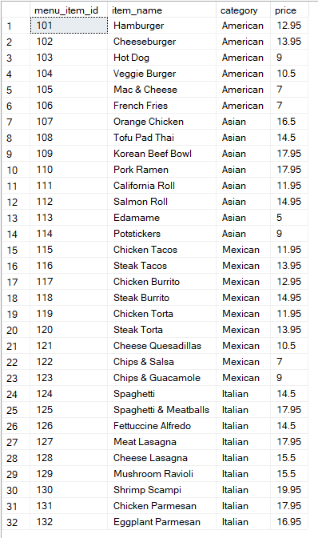
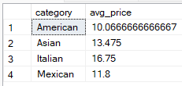
INSIGHTS
We can see the menu item table here in which as we can observe there are 4 different categories.
We can also the observe the average prices for the four different categories.

Slide 6
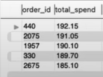
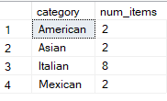
INSIGHTS
We can also observe here top 5 orders that
spent most money.
We can also observe the top order_id #440
spend analysis on different categories.

Slide 7
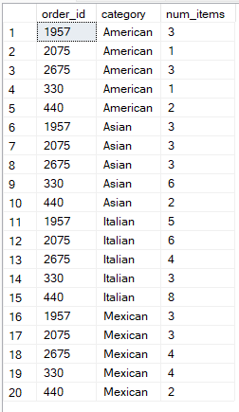
INSIGHTS
We can also observe the details of the top 5 highest spend order over here.

Slide 8
Findings
We can observe that there is a great demand for Italian dishes .
Even though the prices for Italian dishes is high the customer liked it most.
The top five customers has also more likely ordered the Italian dishes over others.
The highest spend is also the Italian dishes with the top customer ordering it over 8 times.

Slide 9
THANK You
BHAGYAVANTHA​​

